Slide 1
Database Management Systems I
SQL ctd..
Lecture 7

Slide 2
In this lecture you will learn
The basic concepts and principles of SQL
How to use SQL(DML) to perform basic database queries

Slide 3
Structured Query Language (contd.)
SQL has one basic statement for retrieving information from a database called the SELECT clause
SELECT clause has many options and hence we will introduce the feature gradually…

Slide 4
Structured Query Language
Basic SELECT clause…
  SELECT <attribute-list>
  FROM <table-list>
  WHERE <condition>
  <attribute-list> is a list of column names
  <table-list> is a list of tables which the query accesses
  <condition> is the condition that the output rows must satisfy

Slide 5
Structured Query Language contd.
Example:
Employee(eid, ename, salary, deptno)
Department(dno,dname, location)

Slide 6
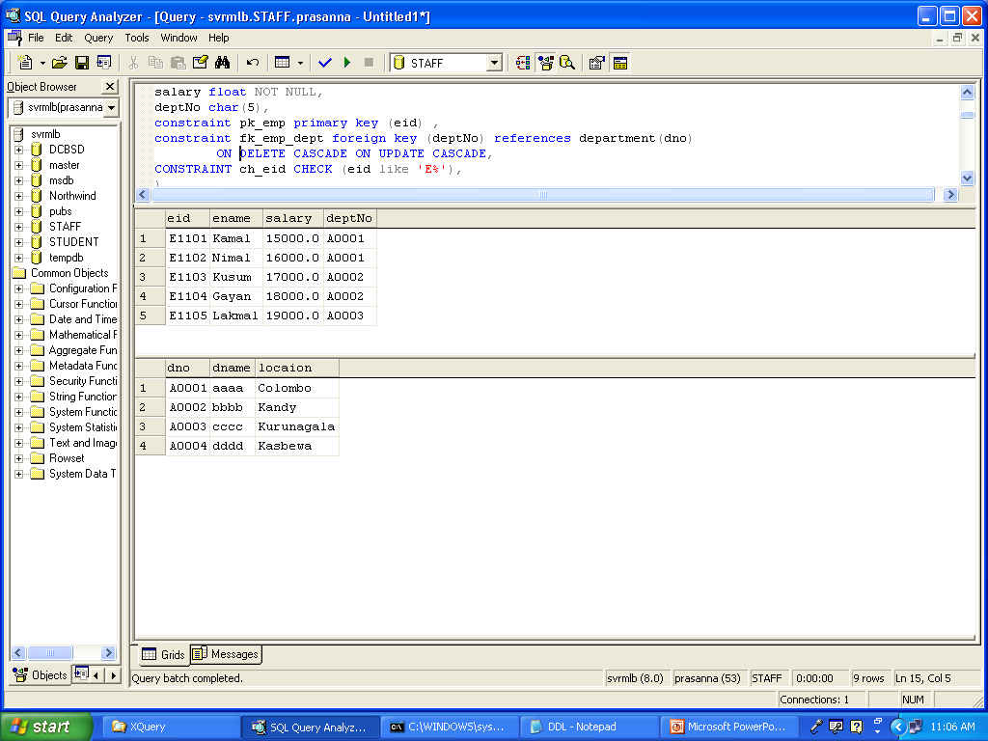
Structured Query Language contd.

Slide 7
Structured Query Language contd.
Select names of all employees
  SELET ename
  FROM Employee
Select names of employees working in the dept A0001
  SELECT ename
  FROM Employee
  WHERE deptno = ‘A0001’

Slide 8
Structured Query Language contd.
Use of Asterisk (*)
* means all columns
Example…
SELECT *
FROM Employee

Slide 9
Structured Query Language contd.
Duplicates are maintained in SQL tables. Also, SQL queries allow duplicates
ALL (by default) – allows duplicates
DISTINCT – disallow duplicates
For example…
SELECT ALL deptno
FROM Employee
SELECT DISTINCT deptno
FROM Employee

Slide 10
Structured Query Language contd.
Example…
List all the department names which are in ‘Colombo’
SELECT dname
FROM Department
WHERE location = ‘Colombo’

Slide 11
Structured Query Language contd.
List all the department names which are in Colombo OR Kandy
SELECT DISTINCT dname
FROM Department
WHERE location = ‘Colombo’ OR
location = ‘Kandy’

Slide 12
Structured Query Language contd.
List all the employee names who are in department A0001 and salary grater than 10000
SELECT ename
FROM Employee
WHERE deptno = ‘A0001’ AND
salary > 100000

Slide 13
Structured Query Language contd.
JOINS
  List the employee information with their department details who are working in departments

Slide 14
Structured Query Language contd.
SELECT *
FROM Employee, Department
WHERE deptno = dno

Slide 15
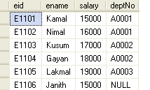
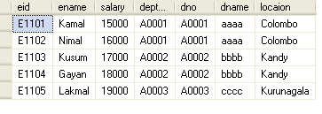
Structured Query Language contd.

Slide 16
Structured Query Language contd.
Example…
Print the names of employees and the names of their working departments
SELECT ename, dname
FROM Employee, Department
WHERE deptno = dno

Slide 17
Structured Query Language contd.
Renaming & Aliasing…
Sometimes the same attribute name appears in multiple tables of the FROM clause. Then we need to use the table name with attribute name to identify attributes separately.
Sometime need to change the field name of display. Then rename the it.

Slide 18
Structured Query Language contd.
For example …
SELECT employee.ename, department.dname
FROM employee, department
WHERE employee.deptno = department.dno
SELECT e.ename AS EmployeeName, d.dname AS Department Name
FROM employee e, department d
WHERE e.deptno = d.dno

Slide 19
Structured Query Language contd.
Product (pname, price, category, manufacturer)
Company (cname, stockPrice, country)
Find all products under $200 manufactured in Japan;
print their names and prices.
Join
between Product
and Company
SELECT PName, Price
FROM Product, Company
WHERE Manufacturer=CName AND Country=‘Japan’
AND Price <= 200

Slide 20
Structured Query Language contd.
Product
PName | Price | Category | Manufacturer
Gizmo | $19.99 | Gadgets | GizmoWorks
Powergizmo | $29.99 | Gadgets | GizmoWorks
SingleTouch | $149.99 | Photography | Canon
MultiTouch | $203.99 | Household | Hitachi
Company
CName | StockPrice | Country
GizmoWorks | 25 | USA
Canon | 65 | Japan
Hitachi | 15 | Japan

Slide 21
Structured Query Language contd.
Product
Company
PName | Price | Category | Manufacturer
Gizmo | $19.99 | Gadgets | GizmoWorks
Powergizmo | $29.99 | Gadgets | GizmoWorks
SingleTouch | $149.99 | Photography | Canon
MultiTouch | $203.99 | Household | Hitachi
Cname | StockPrice | Country
GizmoWorks | 25 | USA
Canon | 65 | Japan
Hitachi | 15 | Japan
SELECT PName, Price
FROM Product, Company
WHERE Manufacturer=CName AND Country=‘Japan’ AND
Price <= 200
PName | Price
SingleTouch | $149.99

Slide 22
?
Questions!

Slide 23
Exercises…
Employee(eid, name, salary, dept, address)
Dept(deptNo,dname, building, mgr)
Print all employee names
Print names of employees working for ‘Administration’ (i.e. dname) department
Print names of employees working for ‘Administration’ (i.e. dname) department and getting a salary > Rs. 50,000.

Slide 24
Exercises… (contd.)
Print the employee’s name, his/her department and his/her manager’s name
Print names of employees who are managers. If an employee is managing more than one department, print his/her name only once.
Print names of employees managing ‘Administration’ and ‘Sales’ department. If the same employee is managing both departments, repeat his/her name twice.

Slide 25
Exercises… (contd.)
Print the names of employees whose names have a letter ‘A’ or ‘a’ in them
Print names of employees whose address contains the following string ‘_olombo’ where _ is any character
Print names, deptNos, and salaries of employees, Order firstly in ascending order by deptNos and then salary by descending order
Print the names of employees who are not working for any department
Print the names of employees who are working for some department

Slide 26
Exercises
Count the number of employees working for department 5.
Print the maximum and minimum salaries for department 5.
Find the number of employees obtaining a salary greater than the Average salary of all.

